Slide 1
VEHICLE NUMBER PLATE RECOGNITION
KAAVYA SHREE K.S.

Slide 2
PROBLEM STATEMENT
The big combination of software things, under different perspectives of our current day globe, has led to the transformation of vehicles into conceptual resources in the field of data technologies. Since the information application is meaningless without any information as the name implies, there is a huge requirement to redesign the vehicle information among the information systems. It is also be achieved by external agents manually or by special smart system which permits detection and recognition of vehicles by the license plates in real-time environments.

Slide 3
OBJECTIVES
The number plate recognition (NPR) system is one of the categories of smart transportation and detection mechanism (STDM). This is a combination of the technology in which the application enables the system to detect and automatically read the license id of number plate of vehicle from digitally captured images or videos. Automatically capturing the license plate is the process of detecting and transforming the pixels data of a digital image into the plain text data or ASCII text of the number plate.

Slide 4
ARCHITECTURAL DESIGN
Image
Gray scale
Noise reduction
Edge detection
Contour detection
Video
Frame
Separate image
plate recognition
Segmentation
masking
OCR
License plate no

Slide 5
DATASET DESCRIPTION
The basic data set used for this process of Number plate Recognition is a set of images of any orientation.
The images are not required to be at exactly specified dimensions.
The images taken in use can be irrespective of the angle and orientation.
Video input could be of any angle, as only specified frames of those object to be tracked are focused.
Pre-processing steps would be done before processing video inputs.
The image or video data-set used is from the website – Kaggle.

Slide 6
ALGORITHM DESCRIPTION
Initially the image/video taken as input is read as input.
In case of a video file, frames are extracted and the particular frame that is apt for further processing is found to be proceeded.
The input frame/ image is converted to GRAY scale initially.
The Gray scaled image is smoothened by deleting the unwanted pixels by noise reduction.
The smoothened image undergoes edge detection by using CANNY- FILTER.
The counters are found by using the BILATERAL-FILTER for the processed image.
The processed image is helped to recognize the number plate of the vehicle.
The number plate is masked to separate the number plate of that vehicle as a separate image.
The separated image is segmented to single characters.
Finally the OCR is used to recognize the characters in the number plate , that is given as the output.

Slide 7
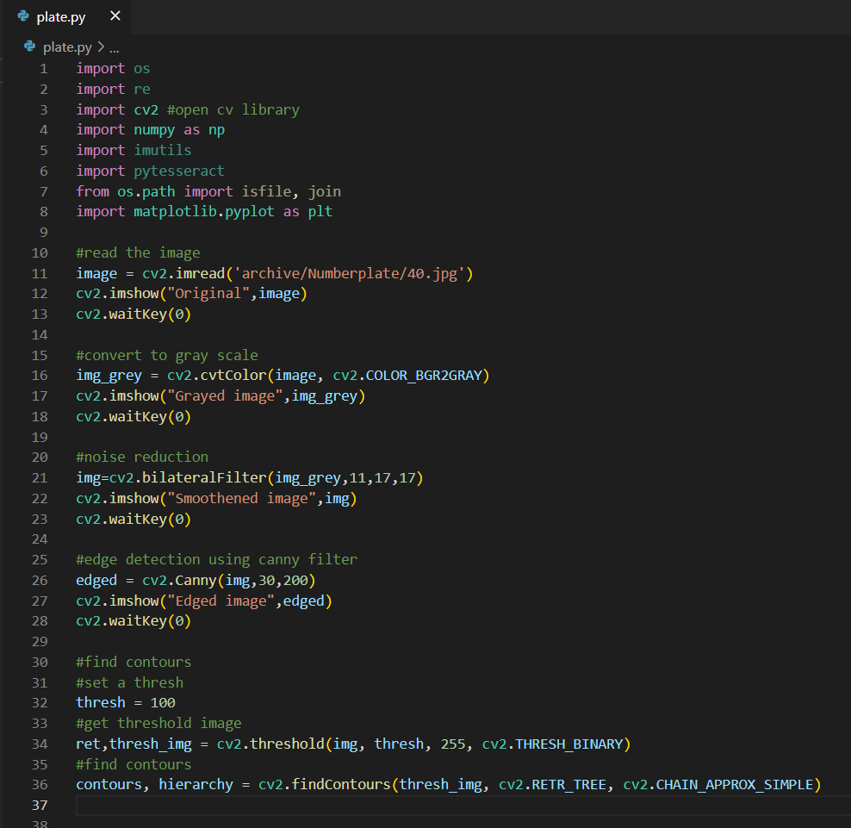
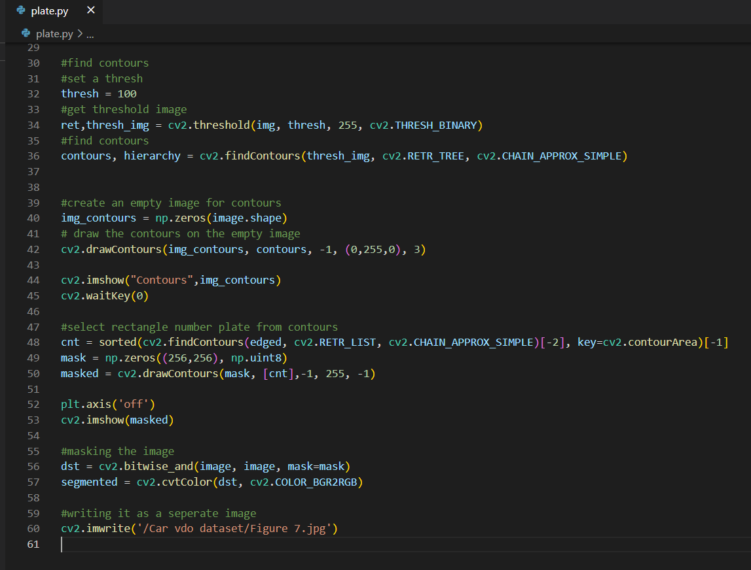
SCREENSHOTS

Slide 8
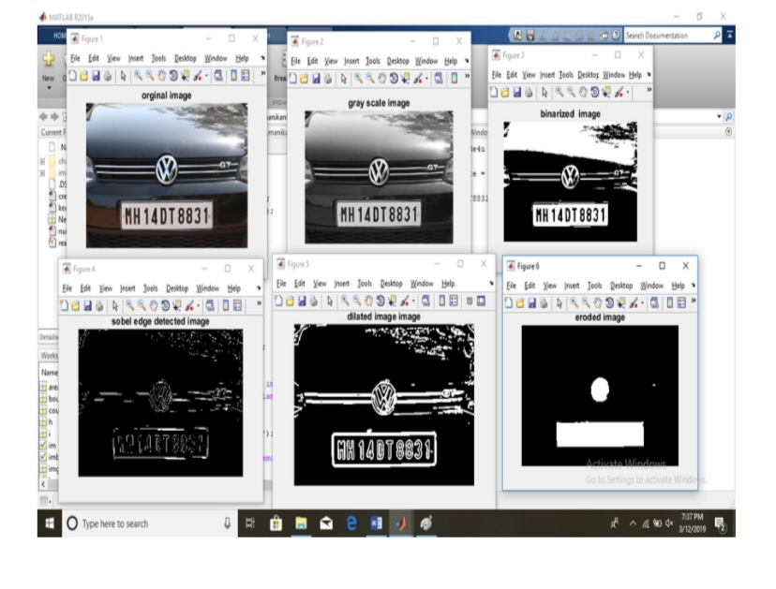
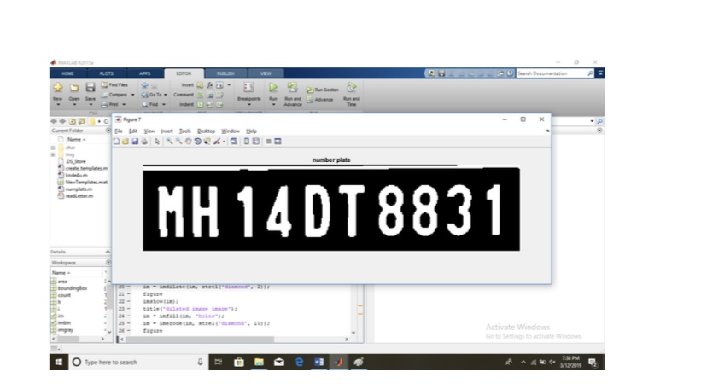
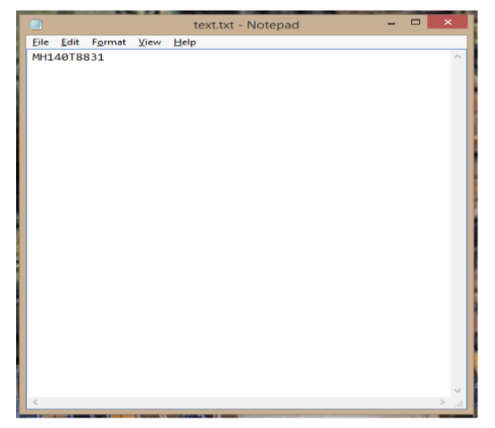
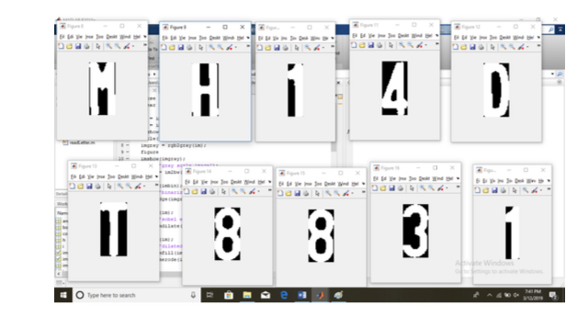
OUTPUT

Slide 9
REFERENCES
https://www.researchgate.net/publication/332687116_NUMBER_PLATE_RECOGNITION_SYSTEM/link/5cc3739a92851c8d220790f0/download - vehicle number plate recognition-Base paper
https://www.analyticsvidhya.com/blog/2020/04/vehicle-detection-opencv-python/#h2_7
https://www.section.io/engineering-education/license-plate-detection-and-recognition-using-opencv-and-pytesseract/
https://www.kaggle.com/datasets/landrykezebou/vriv-vehicle-recognition-in-videos-dataset?select=Toyota_Prius_2005_Blue_02.mp4
https://medium.com/analytics-vidhya/contours-and-convex-hull-in-opencv-python-d7503f6651bc
https://pythonexamples.org/python-opencv-cv2-find-contours-in-image/
https://machinelearningknowledge.ai/image-segmentation-in-python-. pencv/#Image Segmentation_in_OpenCV_Python

Slide 10
THANK YOU

